Slide 1
Lab 6 Recursion

Slide 2
What is Recursion?
The process of calling a function by the function itself is known as Recursion. Well,you can call a main() within the main() function,but you should have a condition that does not call the main() function to terminate the program. Otherwise,the program will never return and run infinitely.

Slide 3
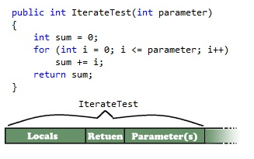
What iteration looks like ?

Slide 4
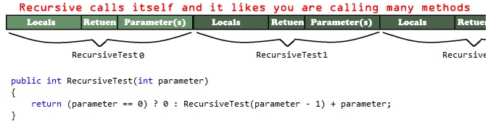
What Recursion looks like ?

Slide 5
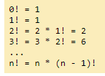
Iteration Factorial example:
FACTORIAL:
public long Factorial(int n)
{
if (n == 0)
return 1;
long value = 1;
for (int i = n; i > 0; i--)
{
value *= i;
}
return value;
}

Slide 6
Recursion version of Factorial
public long Factorial(int n)
{
if (n == 0)//The condition that limits the method for calling itself
return 1;
return n * Factorial(n - 1);
}

Slide 7
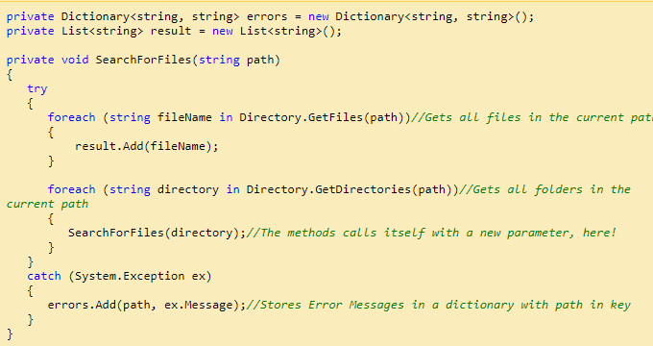
Recursion for finding files

Slide 8
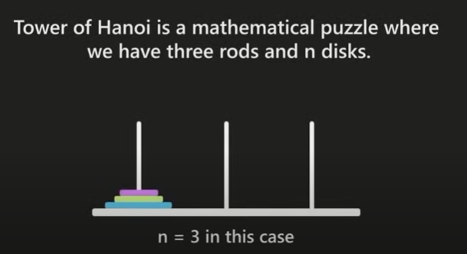

Slide 9
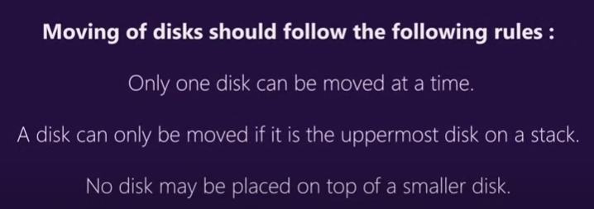

Slide 10
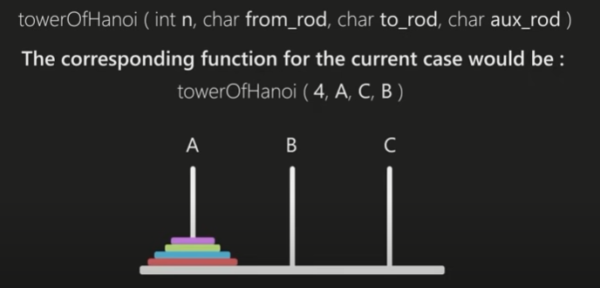

Slide 11
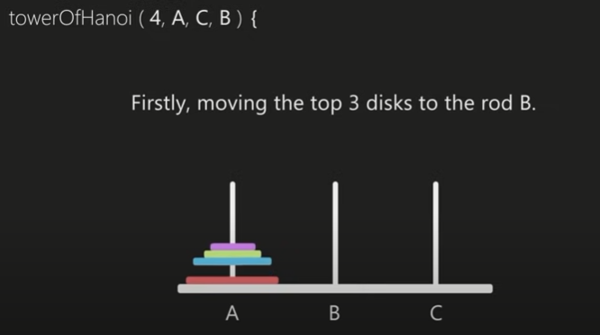

Slide 12
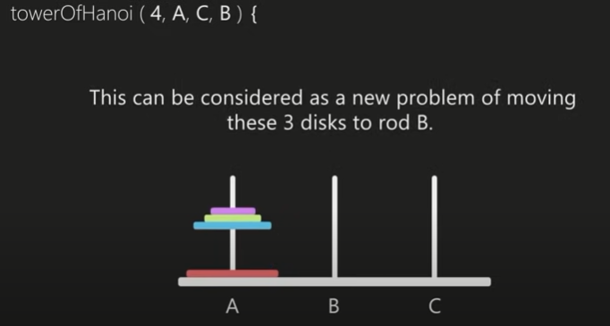

Slide 13
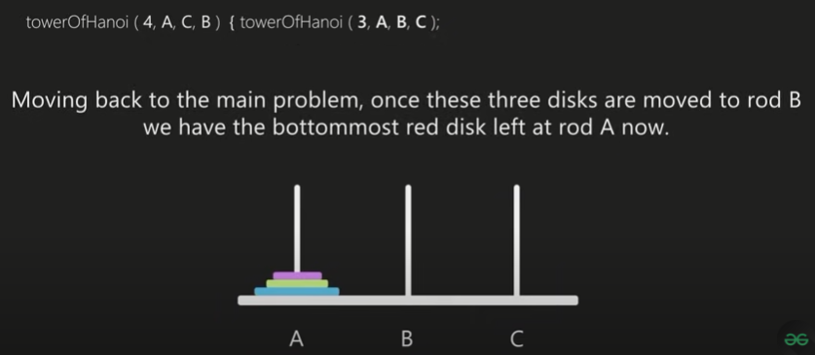

Slide 14
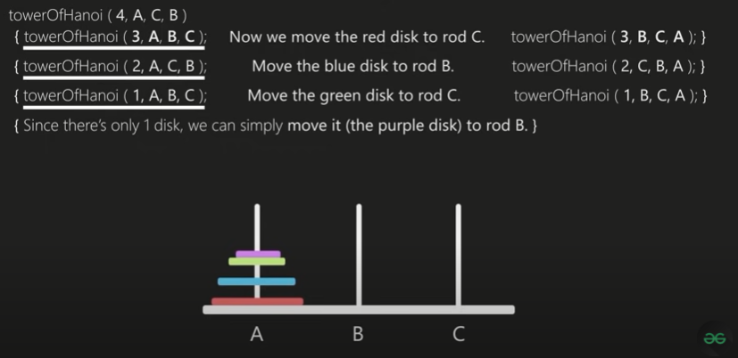

Slide 15
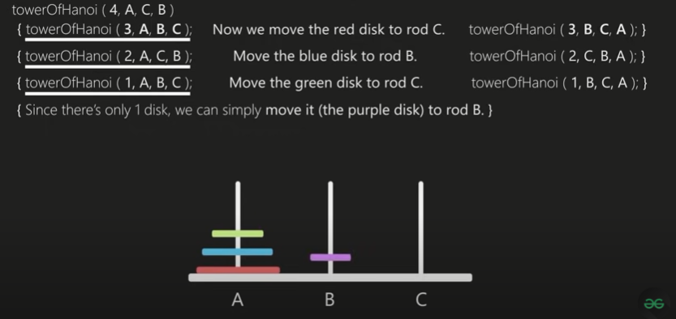

Slide 16
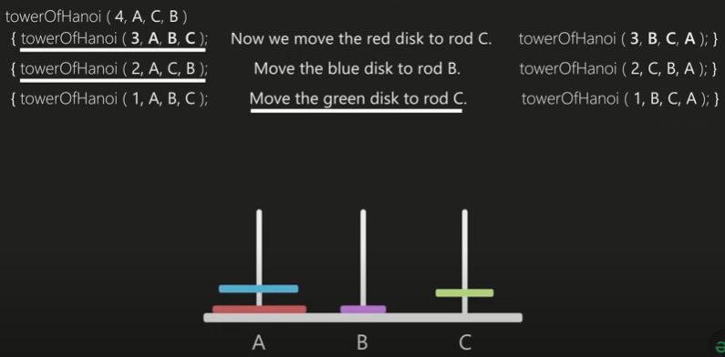

Slide 17
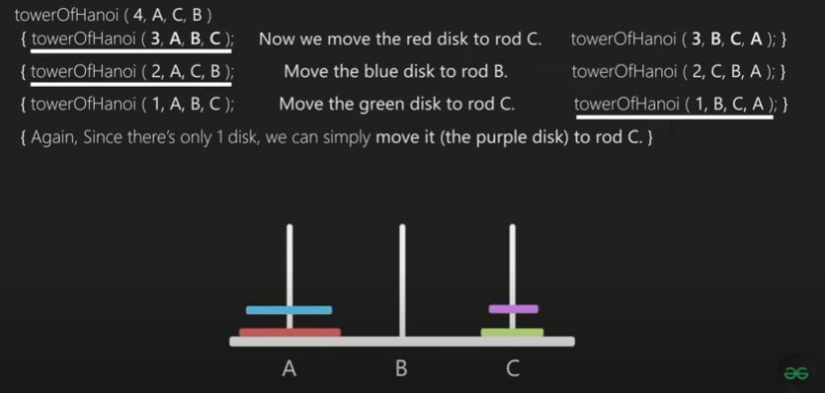

Slide 18
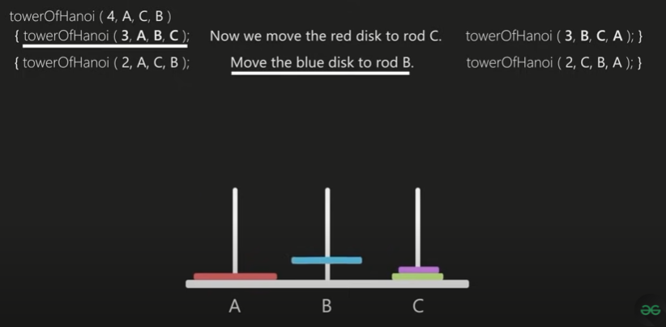

Slide 19
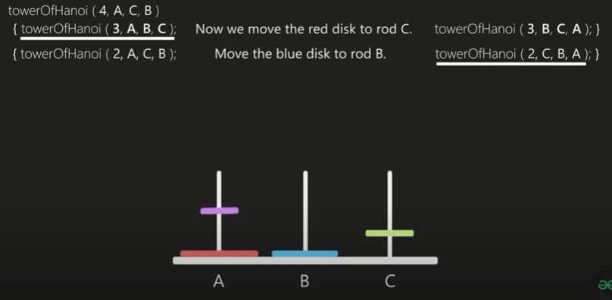

Slide 20
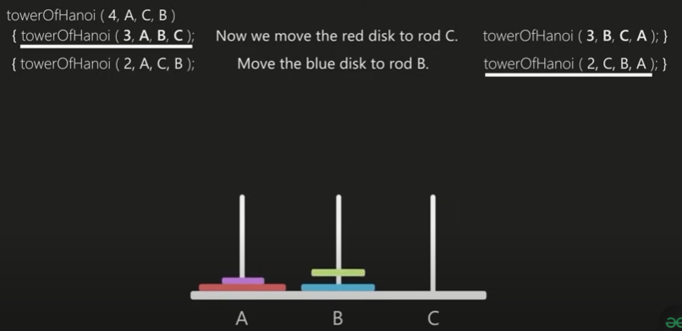

Slide 21
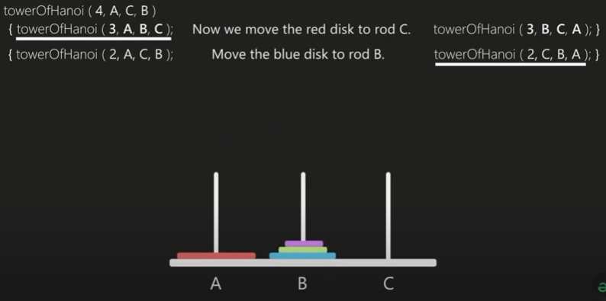

Slide 22
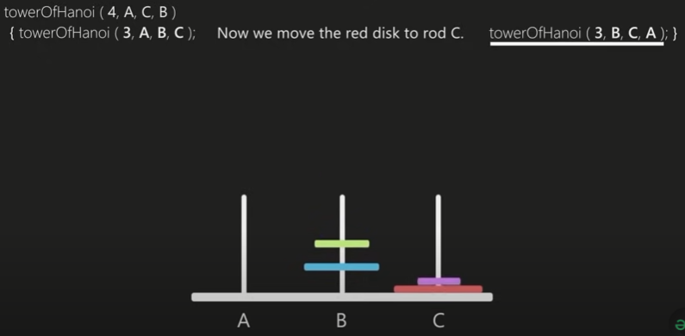

Slide 23
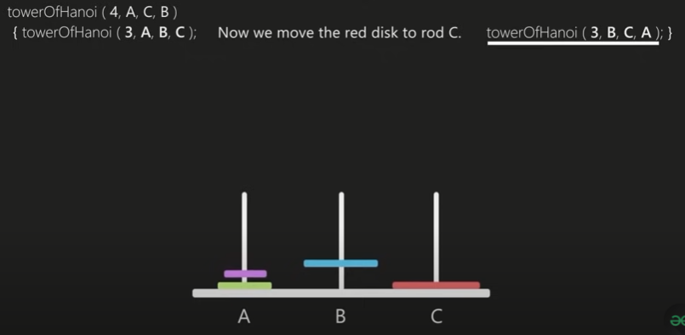

Slide 24
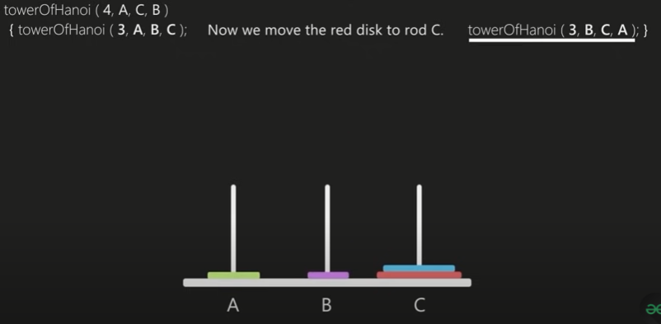

Slide 25
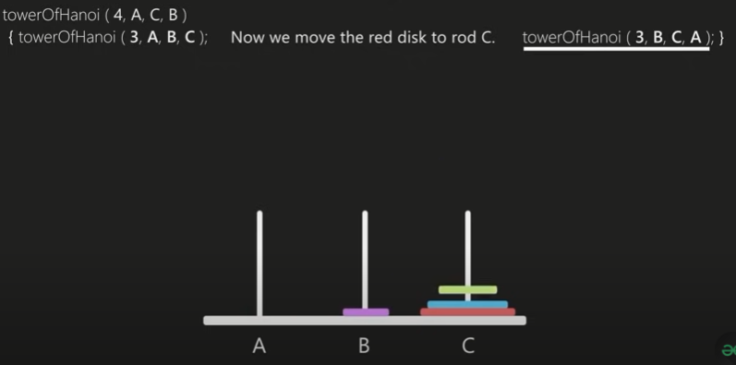

Slide 26
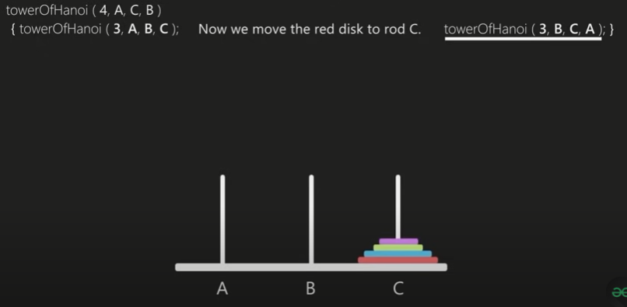

Slide 27
static void towerOfHanoi(int n, char from_rod, char to_rod, char aux_rod)
{
if (n == 1)
{
Console.WriteLine("Move disk 1 from rod " +
from_rod + " to rod " + to_rod);
return;
}
towerOfHanoi(n-1, from_rod, aux_rod, to_rod);
Console.WriteLine("Move disk " + n + " from rod " +
from_rod + " to rod " + to_rod);
towerOfHanoi(n-1, aux_rod, to_rod, from_rod);
}

Slide 28
Main method
// Driver method
public static void Main(String []args)
{
int n = 4; // Number of disks
towerOfHanoi(n, 'A', 'C', 'B'); // A, B and C are names of rods
}

Slide 29
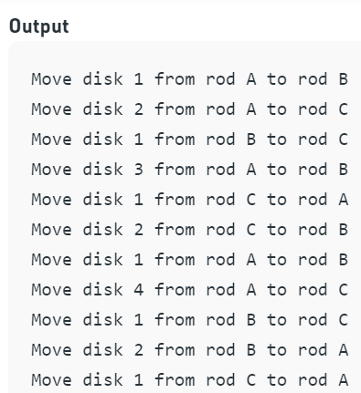
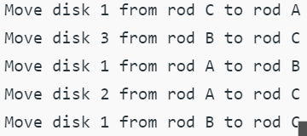

Slide 30
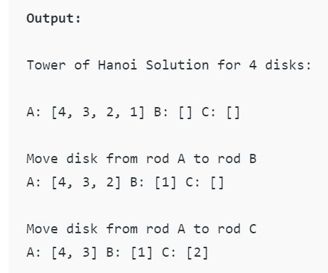
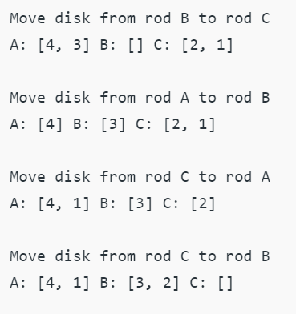

Slide 31
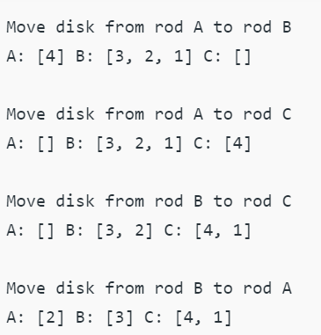
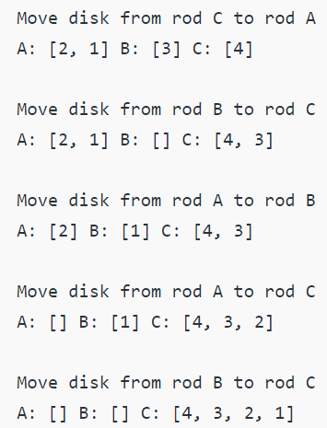

Slide 32
TASKS:
Write a code which prints the following series:
2 4 8 - - - - n
Write a program which calculates the square of a number using odd number series implemented with the help of recursion concept.
Write a program which takes input of an integer number and returns the sum of all numbers. i.e., if input is 3453 then the output should be 15 (3+4+5+3).
Calculation of number of moves for N number of disk in Tower of Hanoi problem using recursion.
Write a program to calculate H.C.F of two numbers, using recursion.
Implement file code

